Slide 1
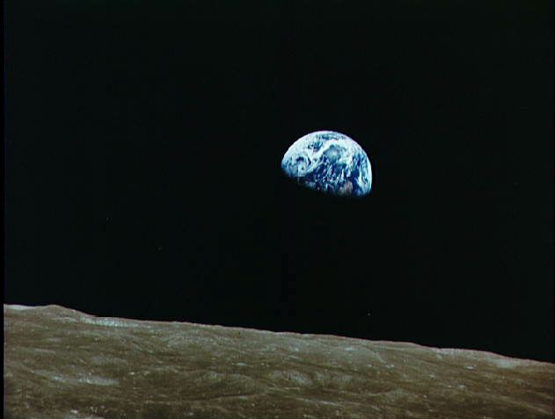
Internal Structure of the Earth
Notes:
slide notes 1

Slide 2
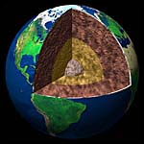
To determine the structure of the Earth, geologists study the way earthquake waves travel through its interior (“seismology”).
Notes:
Our knowledge of the interior of all planets, even our own, is necessarily indirect.

Slide 3
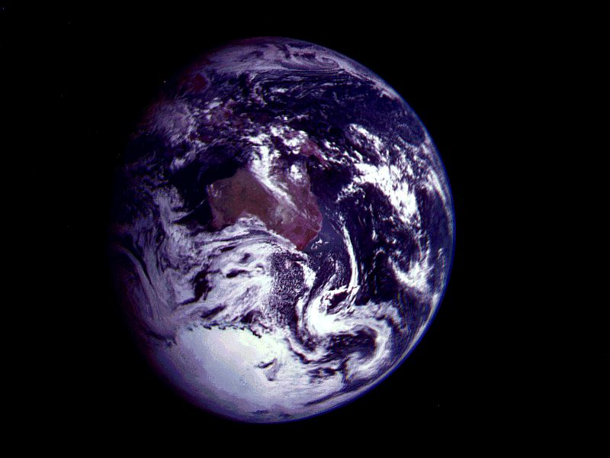
The large-scale model seismologists have come up with for the Earth’s internal structure looks basically like this:
crust
mantle
liquid outer core
solid inner core
Notes:
As we will see, the “terrestrial”, or rocky planets, all have broadly similar internal structures.

Slide 4
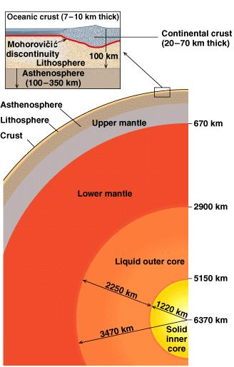
Structure of the Earth

Slide 5
The inner core is composed of the metals Nickel and Iron. This layer is about 1,220 kilometers thick.
The inner core is hot (temperatures up to nearly 5000 C. It is interesting to note that this layer is a SOLID, not a liquid like the outer core due to the intense pressure here.
solid inner core
Notes:
As they rotate, the core only gains about 1 degree on the rest of the Earth each year.

Slide 6
The outer core extends out to almost one-third of the Earth’s radius.
Seismological evidence suggests that the outer core is hot, liquid and metallic, but its exact composition is not known for certain.
liquid outer core
Notes:
As we will see in the next Activity, as the Earth rotates, the liquid metals in the outer core establish currents which are believed to set up the Earth’s magnetic field.

Slide 7
The mantle of the Earth is composed mostly of Silicon, Oxygen, Aluminum and Iron.
The mantle is approximately 2900 kilometers thick, making it Earth's largest layer.
mantle
Temperatures approx.
2 200 C down to 1 200 C,
the mantle is still hot enough to undergo plastic flow-that is, move in convective currents like
those in water heated on a stove.
Mantle is separated from the core with a discontinuity known as Guttenberg.
Notes:
At these temperatures, even solids can flow.

Slide 8
Earth's crust is primarily composed of Oxygen, Silicon, Aluminum, Iron, Calcium, Sodium, Potassium and Magnesium.
Crust is separated from mantle with a discontinuity known as Mohorovicic.
crust
It is made up of two distinct layers, the sial layer, composed of the igneous rock Granite, and the sima layer, composed of the igneous rock Basalt.
Notes:
Now we’ll look at the way that the crust and
mantle act together to produce plate tectonics.

Slide 9
Continental crust consists of both the sial and sima type crust.
The crust beneath the continents averages 35 kilometers thick.
The crust beneath the oceans is made up of only the sima type crust and its thickness averages only about 7 kilometers.
The crust resembles the shell of a cracked hard-boiled egg.
It is broken into about 21 different pieces, called Lithospheric Plates or crust plates.
There are seven major lithospheric plates.

Slide 10
The convective currents in the Earth’s mantle are driven by the considerable temperature difference between the hot core (approaching 5000 C) and the relatively cool crust.
The Earth’s crust is made up of a number of separate
continental & oceanic plates, all floating on these currents.
The convective currents
in the mantle drag
along regions of the
(thin) crust.
Notes:
Note that, on average, the convective currents occur in clockwise & anticlockwise pairs.

Slide 11
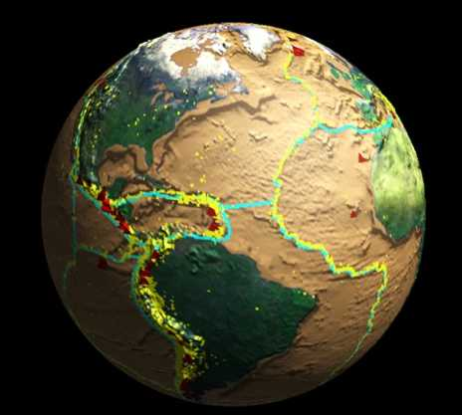
This NASA globe shows the
boundaries between
some of Earth’s
tectonic plates, with
associated volcano
& earthquake
regions.

Slide 12
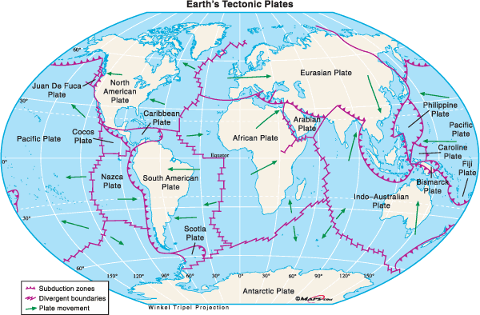

Slide 13
Image Credits
NASA Photo AS08-14-2392: High-oblique view of Moon’s surface showing earth rising above horizon
http://images.jsc.nasa.gov/images/pao/AS8/10074963.jpg
NASA Photo NUMBER p-41508c: Image of the Earth and Moon from Galileo
http://nssdc.gsfc.nasa.gov/image/planetary/earth/gal_earth_moon.jpg
NASA: View of Australia
http://nssdc.gsfc.nasa.gov/image/planetary/earth/gal_australia.jpg
NASA: Volcanoes & Earthquakes
http://www.hq.nasa.gov/office/ese/gallery/Originals/Volcanes&Quakes.jpg
NASA: The Western Himalayas (from the Shuttle Atlantis)
http://kidsat.jpl.nasa.gov/kidsat/exploration/explorations/ESC.00212656/index.html

